Slide 1
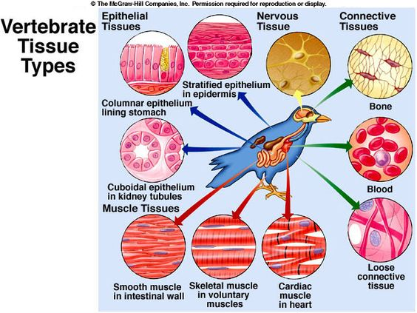
Type of Tissue 1
اعداد
د. كاترين بندر فرج

Slide 2
Tissue. A group of similar cell that are specialized to do a specific function These tissues vary in structure, function and origin
Organs : consists of different types of tissue that are united together to perform a certain function
Histology : is defined as the scientific study of the microscopic structure (microanatomy) of cells and tissues

Slide 3
Type of tissue There are four basic type of tissue
1. Epithelial tissue refers to group of epithelial Cells that package tightly together and form continuous sheets that lines organs and outer body surfaces, vessels, body cavities and also forms glands.
Example of epithelial tissue coverings of surfaces of the body such as Skin, Mouth, Nasal cavity , Lines internal body surface such as GI tract, Lungs, Urinary bladder.

Slide 4
Function of epithelial tissue
1.Protection: skin protects from sunlight, bacteria, physical damage 2.Absorption: lining of small intestine, absorbing nutrient into blood. 3. Filtration: lining of kidney tubules filtration waste from blood plasma 4.Secretion: different glands perspiration, hormones, digestive enzymes and mucus

Slide 6
2. Connective Tissue is one of the basic type of Tissue that supports, protects, and gives structure to other tissues and organs in the body.
Example of connective tissue include bone, cartilage, fat, blood, is also classified as a specialized connective tissue
Connective tissue consist of
1.Connective tissue cells
2. Gel –like substance
3. Fibers (elastic and collagenous fibers)
4. Blood vessels

Slide 7
General Functions
1.Provide a matrix that serves to connect and bind the cells and organs
2.Give mechanical support to the body
3.Storage of fat and certain minerals like calcium in the bones
4.Exchange of metabolites between blood and tissues
5.Significant role in the repair and healing of wounds
6.For protection against infection

Slide 9
3. Muscle Tissue : is one of four basic type of tissue is made up of bands of cells that contract and relax to allow movement and returned to its original size and shape.
Muscle Tissue divided into:
1.Skeletal muscle : or called striated muscle is responsible for the voluntary movement of the body. cells of skeletal muscle are large, cylindrical, and elongated .
For example
movement of the limbs, skin of the face. Contraction of skeletal muscle tissue is rapid and strong.

Slide 10
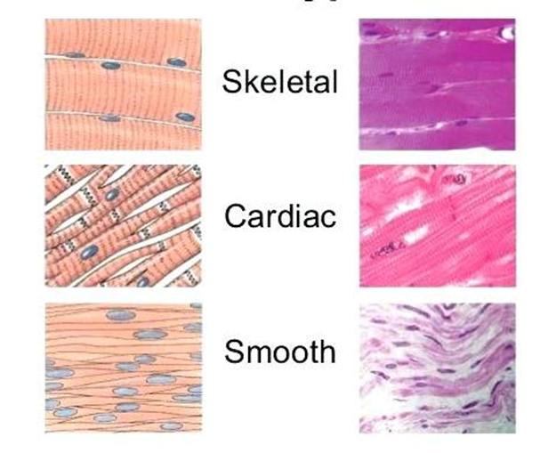

Slide 11
2. Cardiac muscle : it is present only in the heart , cardiac muscle is striated similar to the skeletal muscle and the fibers are shorter than skeletal muscle fibers and usually contain only one nucleus which is located in the central region of the cell ,Cardiac muscle tissue works to keep your heart pumping through involuntary movements
3. Smooth muscle : is associated with arteries and tubular organs such as the intestinal tract, slow involuntary movements. Smooth muscle cells are spindle shaped with one central nucleus, therefore smooth muscle tissue does not appear striated.

Slide 12
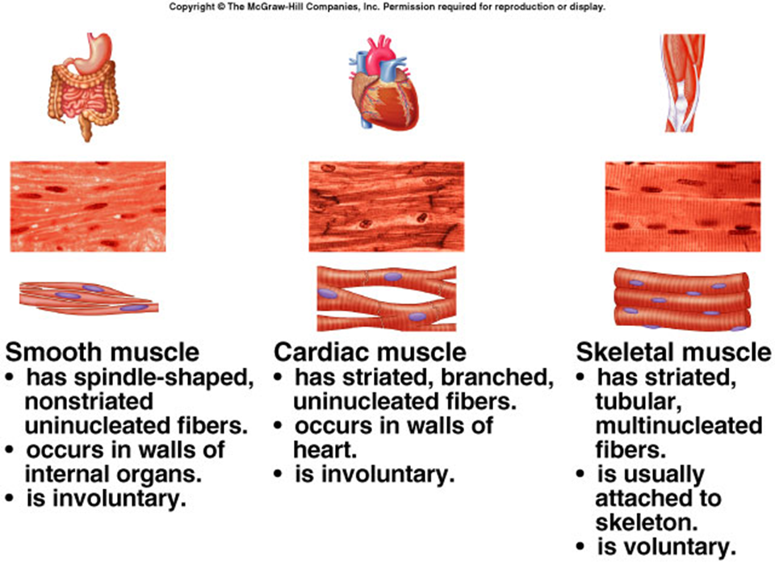

Slide 13
Nervous Tissue. is the main tissue of our nervous system. Its composed of the two parts of the nervous system; the brain and spinal cord of the central nervous system (CNS), and the branching peripheral nerves of the peripheral nervous system (PNS) It monitors and regulates the functions of the body.
Nervous tissue consists of two cells:
1.nerve cells or neurons :are specialized cells that react to stimuli by generating signals through the axons, which are elongated structures arising from the cell body
2. Glial cells or neuroglia : which helps transmit nerve impulses and also provides nutrients to neurons.

Slide 14
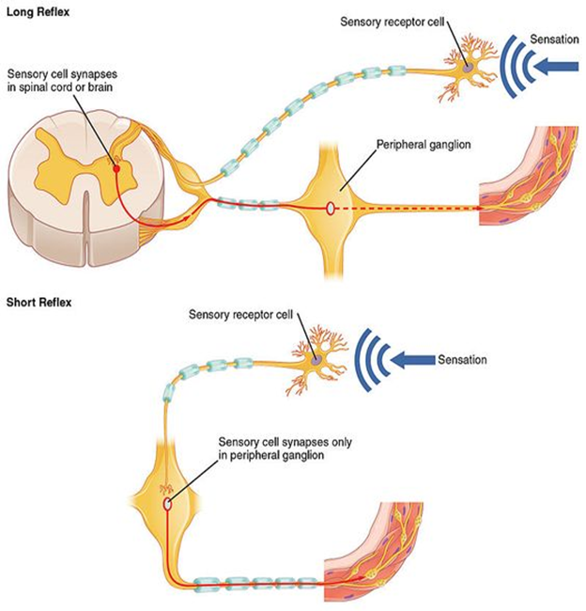

Slide 15
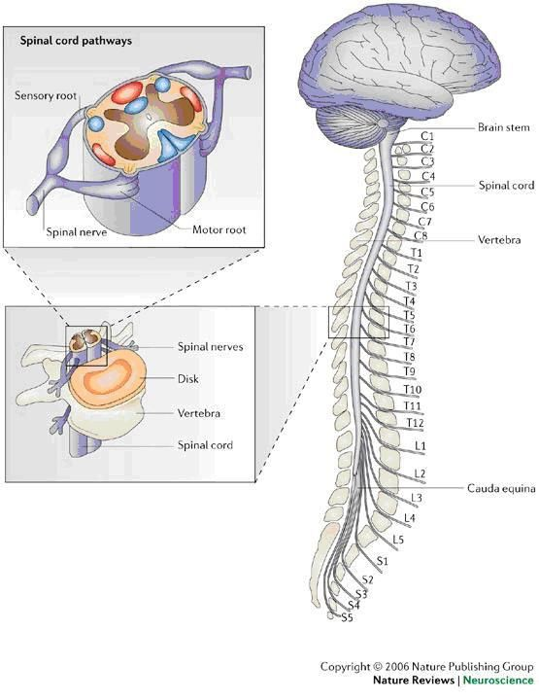
Functions of the nervous system
1.Is responsible for the control of the body and the communication among its parts.
2.control of muscles and glands
3. Homeostasis
4.mental activity.
5.sensory input and integration in
nervous

